Slide 1


What Makes A Song Popular?
Group 5 Project
Kyle Guglielmo, Mamadou Ba,
Eric Yang
Spring 2022
Notes:
Music Is everywhere and we hear it all the time, but how do we know what makes a tune catchy or how do they know which artist to produce? Our project hopes to find out what Makes a song Popular in this project by Mamadou Ba, Eric Yang and Kyle Guglielmo

Slide 2
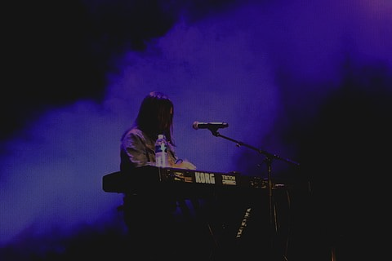
Business Objective
60,000
$2 Million
Who to Produce?
$14 Billion
A year industry
songs a Day added to Spotify
to break into the industry
Notes:
The recording industry is a $14 billion dollar a year industry. Streaming during 2021 accounted for 84% of the revenue. Record labels need to keep spending money to improve their artists rankings by promoting the artists they have signed via advertisements, endorsements or in getting additional airplay on traditional radio. in order to improve the record company’s stake in the ever-toughening music market they would need to find the next most popular music and produce that artist. But how? There are over 60,000 items a day added to Spotify and over 93% are not being released by a major label.
With this many songs being released there is a good chance that that there are several songs that will be popular if properly promoted. But with a price tag of $2million dollars just to break into the pop-music industry not every talent can be promoted. Additionally, Talent scouts cannot listen to every item uploaded daily so we want to know if we can predict if a song will be popular or not based on certain data criteria. We will take a look at the data next.

Slide 3

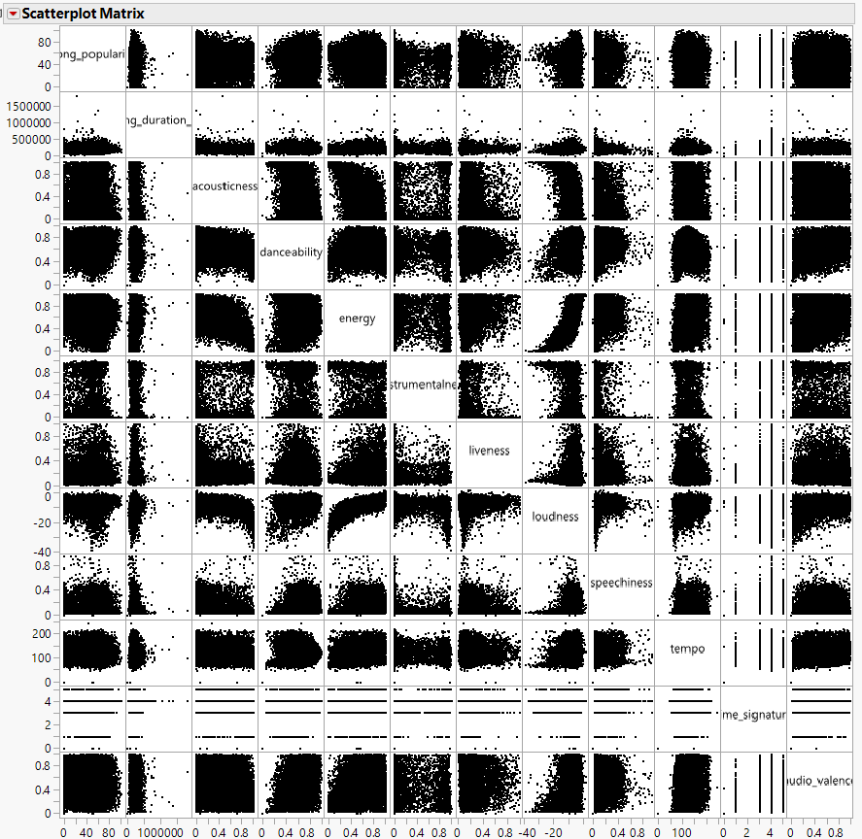
Data Description
18,835
15
Title | Song Title
Popularity | Based on Number of plays
Duration | Length of the song
Acousticness | % of how much of the song is acoustic
Danceability | Tracks suitability for dancing
Energy | Level of perceived intensity
Instrumentalness | % amount of stringed instruments
Key | Which key the song is written
Liveness | Probability of being a live recording
Loudness | average loudness in decibels
Audio Mode | Major or Minor
Speechiness | How much of the song is spoken
Tempo | Beats Per Minute
Time Signature | Timing signature 3/4 or 4/4
Audio Valence | positivity of a song
observations
Variables
Notes:
To start this project we found a dataset on Kaggle that contained 18,835 observations that has 15 different attributes pertaining to musical constructs such as danceability, what key the song is written in, energy, beats per minutes, how acoustic the song sounds, what percentage of the song is vocalized, how long the song is, what the timing signature of the song is and how positive the song sounds. Out of the 15 variables shown on the right. Popularity is the dependent variable that we are looking for and there are 10 continuous variables for us to utilize and 3 categorical variables. We did notice that there is no attribute for genre of the music which we believe is necessary as not all genres may require similar measures. We ran scatterplot matrix to look for correlation between variables and found that there was a high degree of correlation between energy and loudness at .7657. Both loudness and energy had a negative correlation with acousticness at -.6 and -.5. danceability also had a minor correlation with audio valence or how positive a song was.

Slide 4

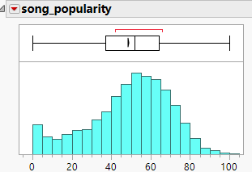
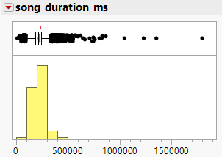
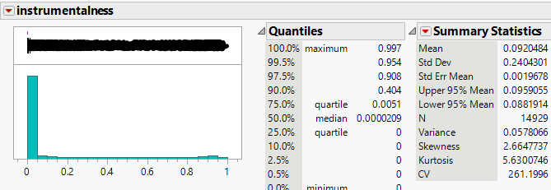
Data Preparation
Remove 3,9000 Duplicates
Dummy Variables for the Key
Standardizing
Notes:
Upon inspecting the data we noticed that there were 3,900 duplicates. we removed the approximately 20% of the data which left us with 14,929 observations left in the dataset. We ran histograms on the datasets to determine if there was any missing or skewed values. We did not find any missing values in our dataset. We did however find skewed values, which we found in song length, acousticness, liveness and speechiness. we ran an outlier analysis on all the categories and found there were only 3 outliers in speechiness and 14 in song duration. We did not remove these outliers as they could be spoken word or acapella songs or possibly long songs by intention such as purple rain full album version. the next thing we did was take the nominal variable Key and transform it into dummy variables. We also standardized many of the continuous variables as tempo and song length had high variation of the scales which does not work well with some of the clustering algorithms. Once the data was prepped it is time to start with a linear regression.

Slide 5


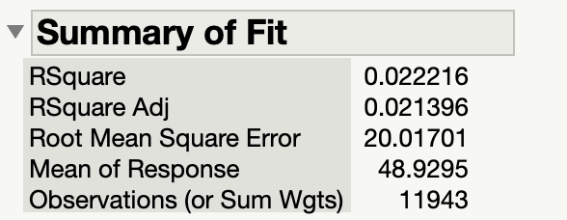
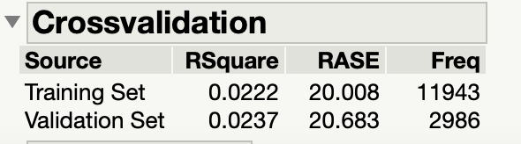
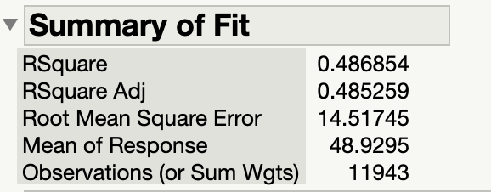
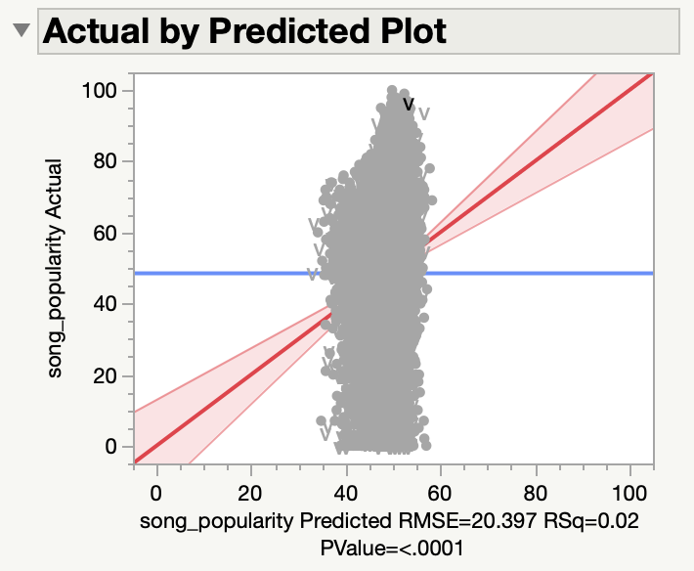
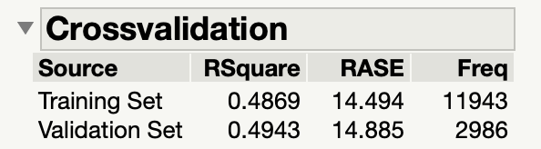

Model Development: K-Means Clustering
Model Development: Linear Regression
Observations
  Very low Goodness of Fit
  Worst predictability in comparison with other models
  Very little to no relationship between song popularity and the predictors in the model
Notes:
The independent variables or predictors used for all of the modeling techniques were acousticness, danceability, energy, instrumentalness, key_6, key_7, liveness, loudness, speechiness, and audio_valence. The data was partitioned using a partition function with a 80/20 split (training data set was 80% of the dataset, while validation data set comprised 20% of the dataset). Linear regression performed the worst out of the modeling techniques that were run with the lowest R^2 and highest RMSE at 0.0222 and 20.008 in the training data set, and 0.0237 and 20.683 in the validation data set. These values show that the data predictors and response variable, song popularity, do not have a direct linear relationship with each other due to the low R^2, and that the model has poor prediction accuracy as shown due to the relatively high RSME.

Slide 6

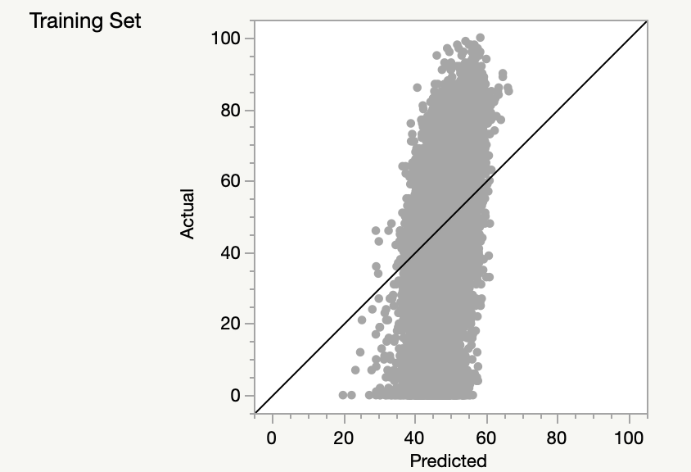
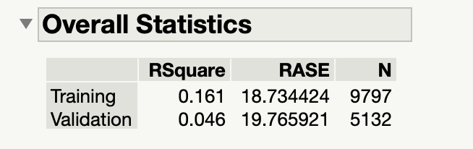
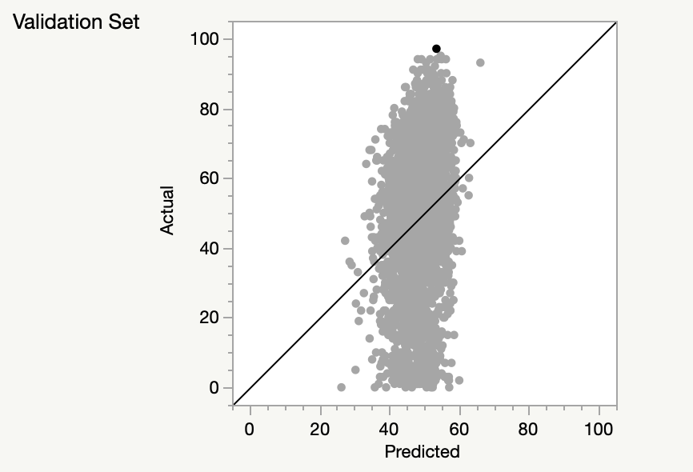
Model Development: K-Means Clustering
Model Development: Boosted Forest
Observations
  Very low goodness of fit, but amongst the four modeling techniques, it is the second best performing one
  Some potential overfitting on the training data
  Improved predictability, but still not very good
  Very little to no relationship between song popularity and the predictors in the model
Notes:
The boosted forest had the second highest R^2 and second lowest RMSE at 0.161 and 18.734 for the training data set as shown in the snapshot of the results above. The validation data set performed worse in comparison to the other models’ R^2 with the second worst one at 0.046, but still maintained the second lowest RMSE at 19.766. This means that there is a possibility that the model overfit the training data. Although it performed better than at least the linear regression, the difference was minimal and it still showed that there is no relationship between the response variable and the predictors due to a low R^2 and relatively high RSME. This statement is further supported by the actual by predicted plots for both the training and validation data sets.

Slide 7
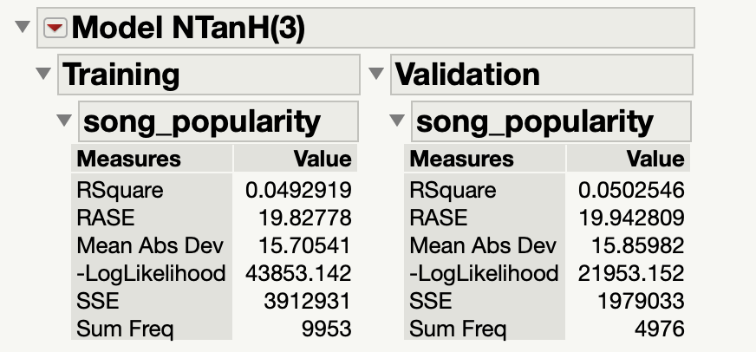
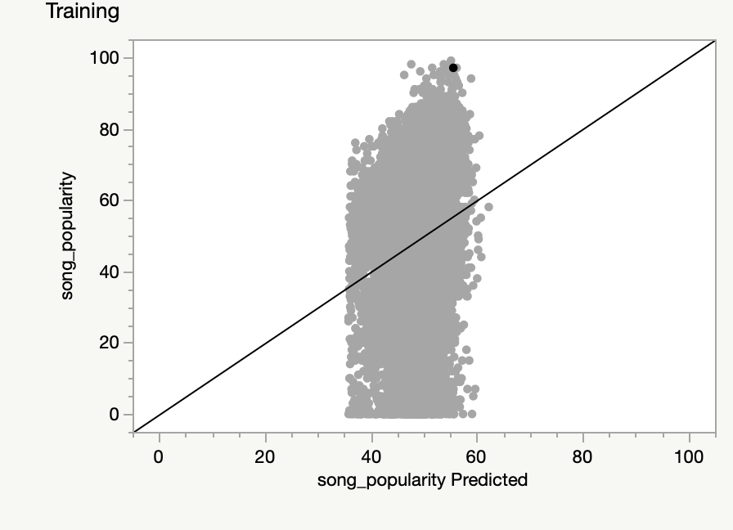
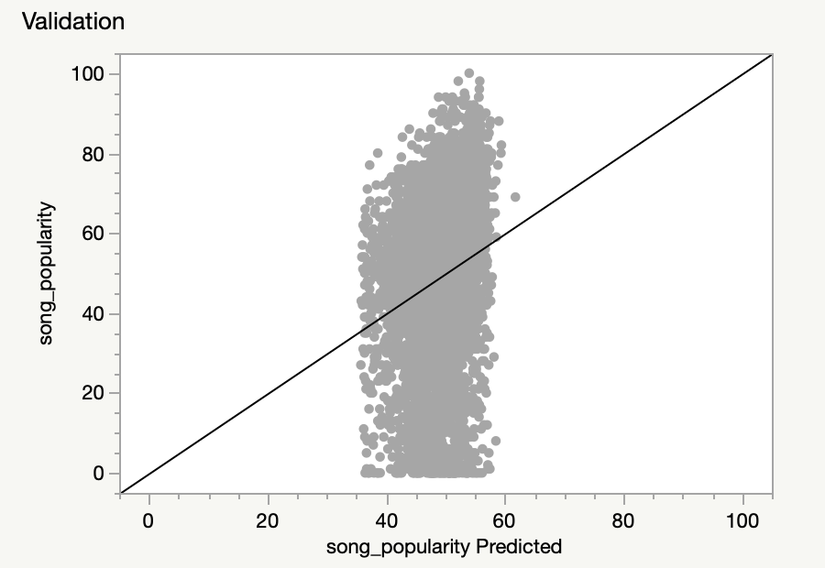
Model Development: K-Means Clustering
Model Development: Neural Network
Observations
  Very low goodness of fit, but performs slightly better than that of Linear Regression
  Very low predictability, but performs slightly better than that of Linear Regression
  Very little to no relationship between song popularity and the predictors in the model
Notes:
The data was partitioned using the holdover partition function at a 67/33 split. Among the models in the training data set, it was the second worst performing model with a R^2 of 0.0493 and RMSE of 19.828 which is the second highest. In the validation data set, it performed a bit better, with the second highest R^2 value at 0.0503, but had the second highest RMSE at 19.943 as shown in the table above. Although the model performed a bit better in the training data set than the validation set, the difference was very minimal, as the low R^2 and relatively high RSME showed that there was and still is very little to no relationship between the response variable and the predictors. This is further supported by the actual by predicted plots for both the validation and training dataset.

Slide 8

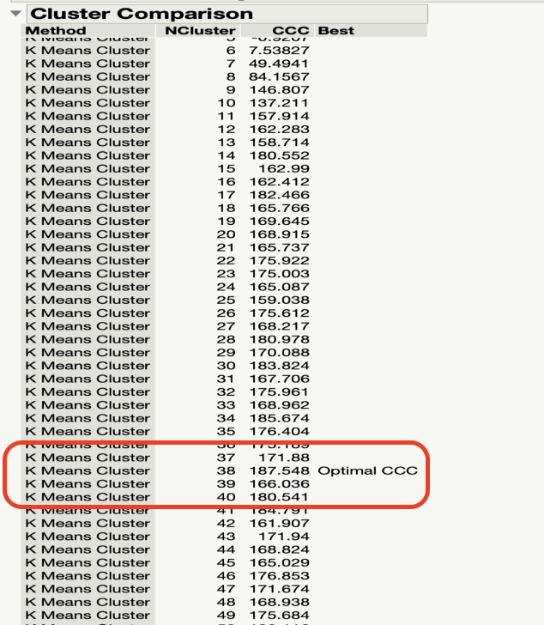
Model Development: K-Means Clustering
80% used for Training.
20% used for Validation.
Notes:
A K-mean clustering is also a model that we tried to implement in this project, where 80% of the dataset is partitioned as a training data and 20% as a validation data.
Based on the cluster comparison result from JMP, the result showed that 38 clusters were found to be the optimal cubic clustering criterion to fit the model.
We also discover that the result of the R^2 value is around 0.49 in both training and validation data, with a Root Average Squared Error of 14.5 for the training set and 14.9 for the validation set.

Slide 9

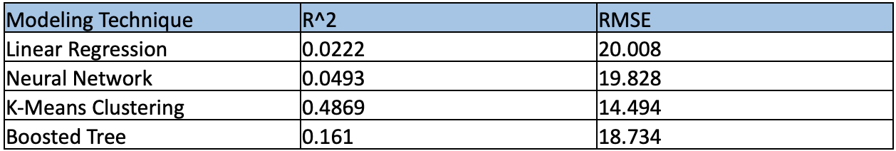
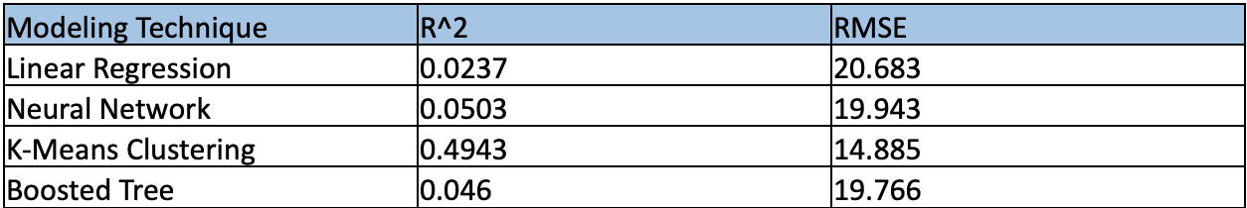
Model Comparison
Model Comparison
K-mean clustering appear to be the best technique among the models to predict song popularity
The linear regression model has the lowest R^Square and the highest Root mean square error among the four models
Training data set
Validation data set
Notes:
In terms of model performance, the model comparison tables for the training and validation data show that the K-mean clustering technique performed better. The Clustering model has the highest R^2 result of 0.48 for the training set and 0.49 for the validation set along with the lowest Root Mean Square Error of 14.4 for the training set and 14.8 for the validation set.
The linear regression technique did not perform well as it has an R^Square result of 0.022 for the training data and 0.023 for the validation set which is the lowest among the four models that we performed, it also has a Root Mean Square Error result of 20.008 for the training data and 20.7 for the validation data which are the highest among the four models.

Slide 10

Conclusion
The K-mean clustering was the best performing prediction algorithm out of all the algorithms that we tested.
Additional data will be needed and allow us to implement a better prediction model for song popularity
Notes:
Due to our limited amount of data, we can conclude that the K-means clustering algorithm is the most suitable technique to predict song popularity among our different models.
So, we know that data mining is not a linear process, we would recommend getting more data related to song popularity in order to increase the model performance.
Other data related to song prediction can be: the number of Youtube views and likes per song, as well as the style, as we think that different musical style will generate different clusters result for song popularity.
This conclude our presentation, on behalf of Kyle and Eric we want to thank you for your time
Thank you!

